Slide 1

Introduction
To Technical Studies
2025
A small demonstration of what to expect if you decide to pursue a bachelor’s program in a technical field.
By: Ana Meker, Wiktor Kwapiński, and Claire Garretsen
Notes:
The guest lesson is meant to provide high school students, who are about to choose which bachelor to pursue, a better idea of what it’s like to do a technical study. This is done by bridging the gap between their regular math and physics knowledge, as well as pre-written code to be able to simulate and solve real-life problems of a highway traffic.

Slide 2
Planning
10 min
55 min
15 min
Introduction
Exercises
Flyer
Q&A
Notes:
The guest lesson takes about 80 minutes in total. Introduction includes introducing the teachers or people giving the workshop. Exercises include math and physics problems that can be solved either on paper or by using prewritten code. Finally, a brief overview is given of a flyer describing many different technical studies in the Netherlands. It is also important to leave some time at the end for Q&A in case the students have questions.

Slide 3
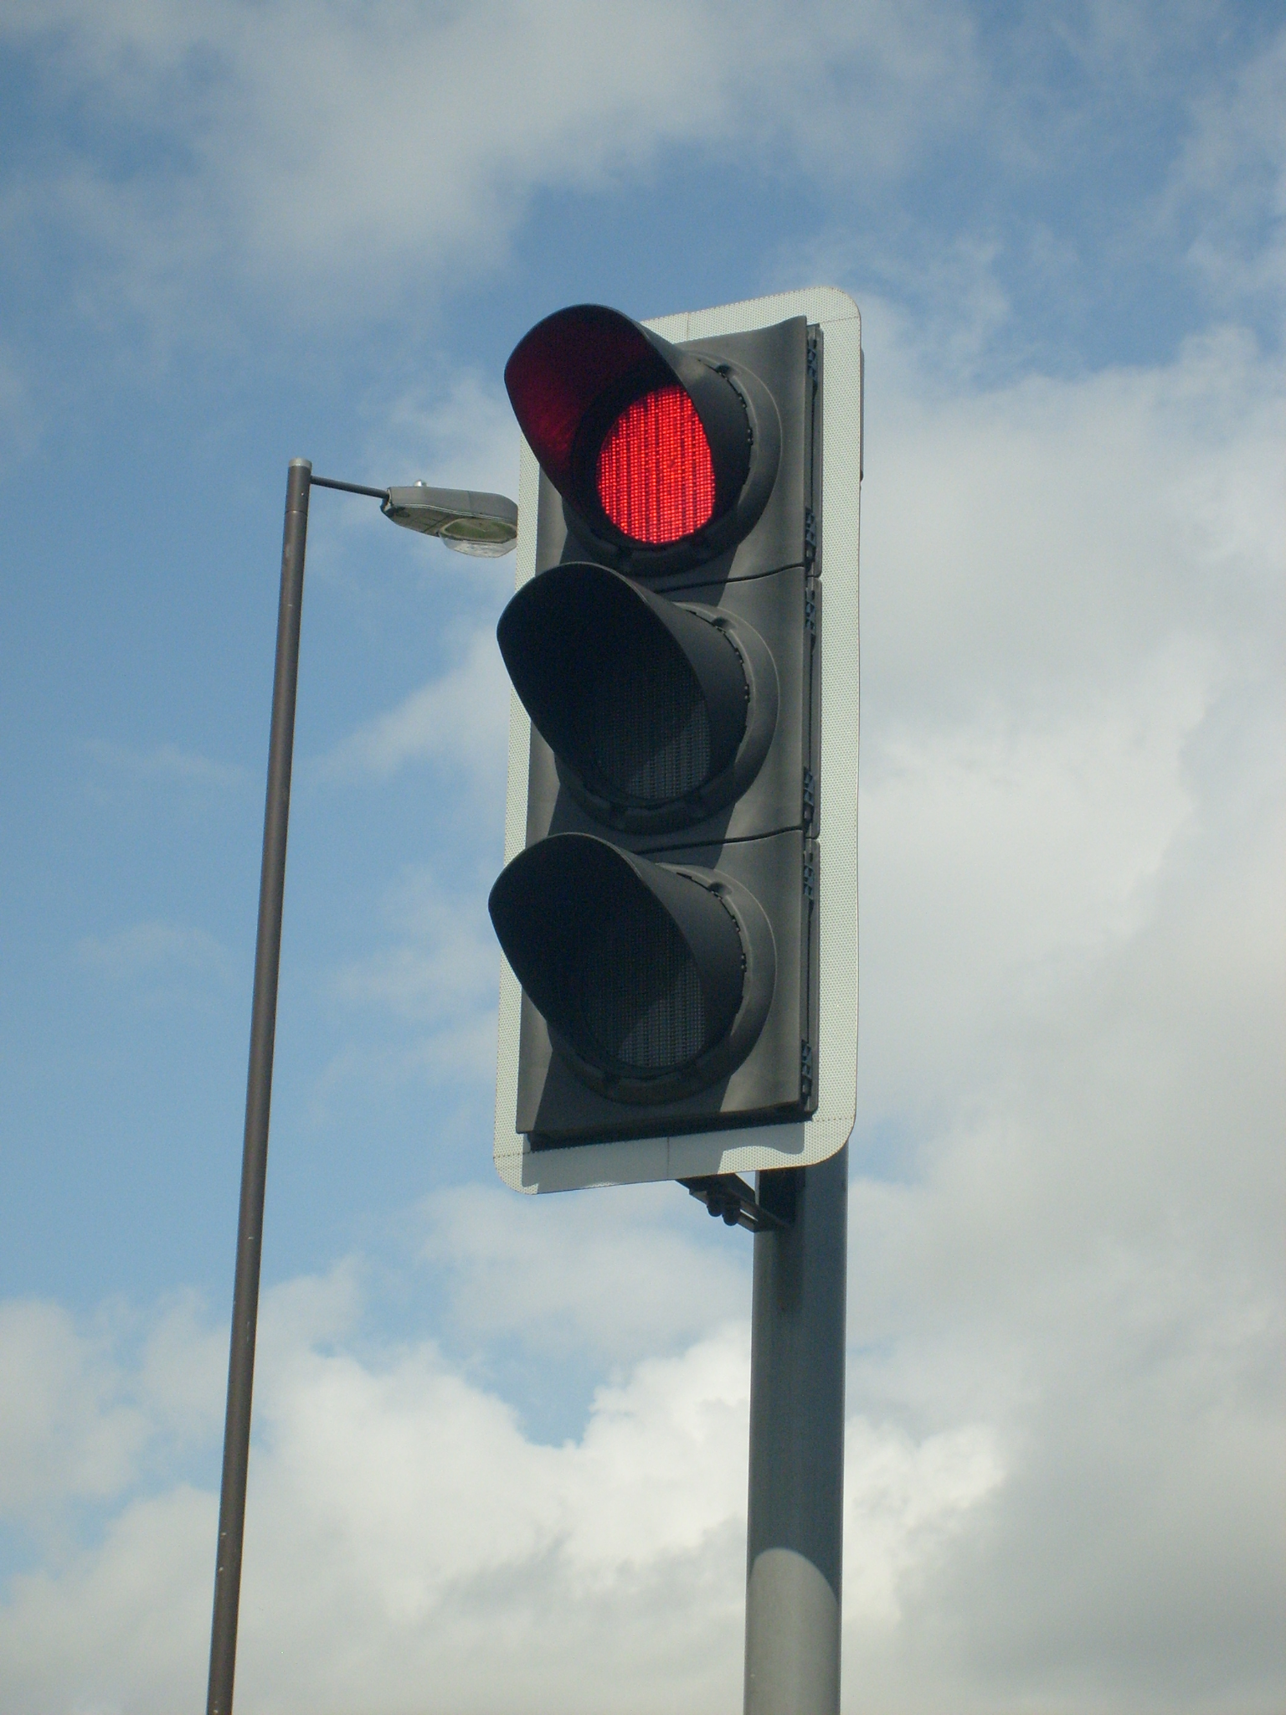
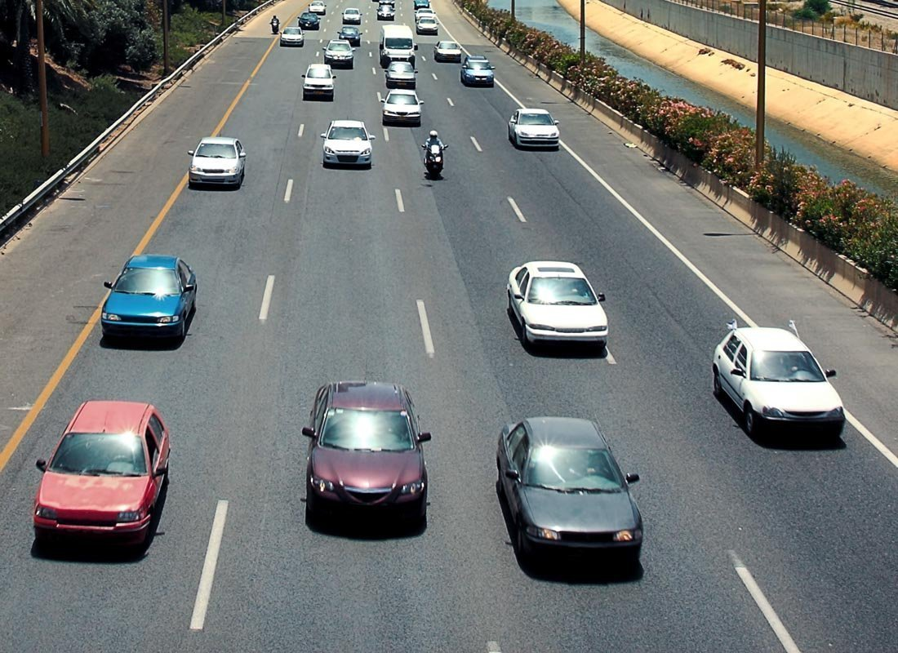
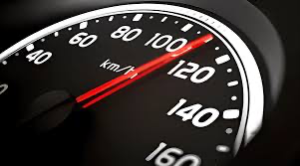
The challenge…

Slide 4


Part 1: Warm-Up Exercises
Warm-up on the theory
t: time
v: velocity
s: distance
a: acceleration
Single car on a highway
Notes:
First part of the workshop is the warm-up exercises. These are meant to freshen up the students’ knowledge of the required math and physics, as well as get them familiar with the Google Colab environment. All exercises in this part are done on paper, and the code is only meant to help visualize and verify the results. For next parts, students will also see cases of where the code can help get to the answers, or even a case when programming is necessary to solve certain questions. All the exercises in part 1 will be about a single car driving on a highway.

Slide 5
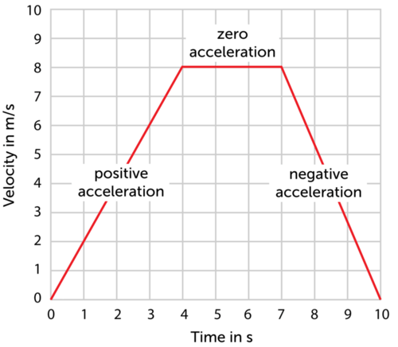
Velocity time graph
Notes:
A refresher on velocity time graphs. At this point the students can be asked to explain what such a graph shows. Make sure they are familiar with the concepts of acceleration and deceleration.

Slide 6
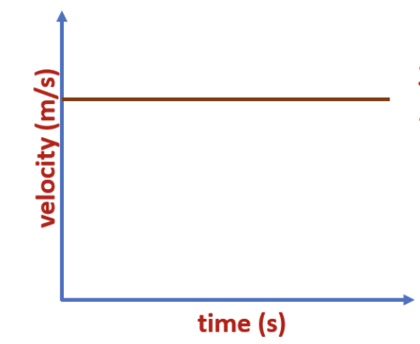
Velocity time graph
Distance = area under graph
Distance
Notes:
Explain that distance can be calculated by taking area under the velocity time graph. In case of a constant velocity, this is just a rectangle.

Slide 7
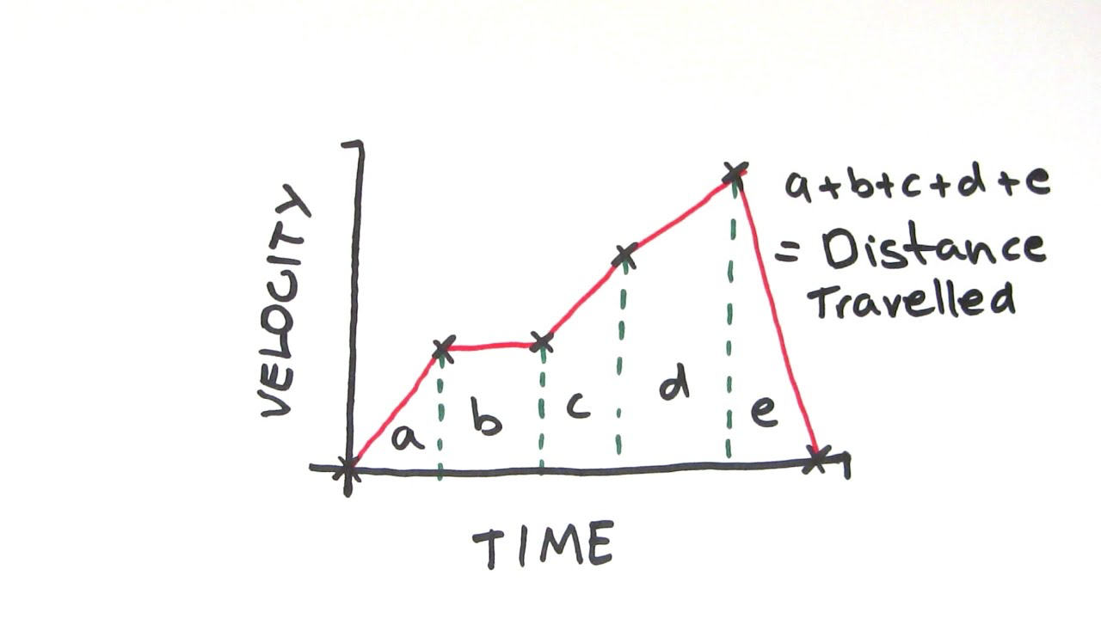
Time, velocity and distance
Constant speed
Variable speed?
Distance = Speed x Time
Notes:
Things get a bit more complicated when the velocity is not constant but changes. However, the total distance covered can still be calculated by taking the area under the graph.

Slide 8
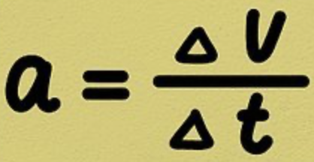
Acceleration
Constant acceleration
Where
ΔV: change in speed
Δt: time difference
Notes:
Provide formula for calculating constant acceleration.

Slide 9
Group 1: https://shorturl.at/…
Group 2: https://shorturl.at/…
Group 3: https://shorturl.at/…
Group 4: https://shorturl.at/…
Notes:
Here, each group is directed to a google drive folder where they can find copies of the Google Colab notebooks for the exercises. (Links need to be adjusted)

Slide 10

Quick guide
Click arrows to run blocks of code
Don’t change the code
You can plug in your answers and then run the blocks
Some blocks take longer to run
Call us if you run into an issue
Notes:
Quick guide to explain how to run blocks of code on Google Colab.

Slide 11

Exercise 1
Question:
Starting from rest, how fast must you accelerate to reach 100 km/h (27.78 m/s) in 20 seconds? Assume constant acceleration. Give your answer in m/s².
0 km/h
100 km/h
t = 0 s
t = 20 s
Notes:
Tell students to pay attention to units.

Slide 12
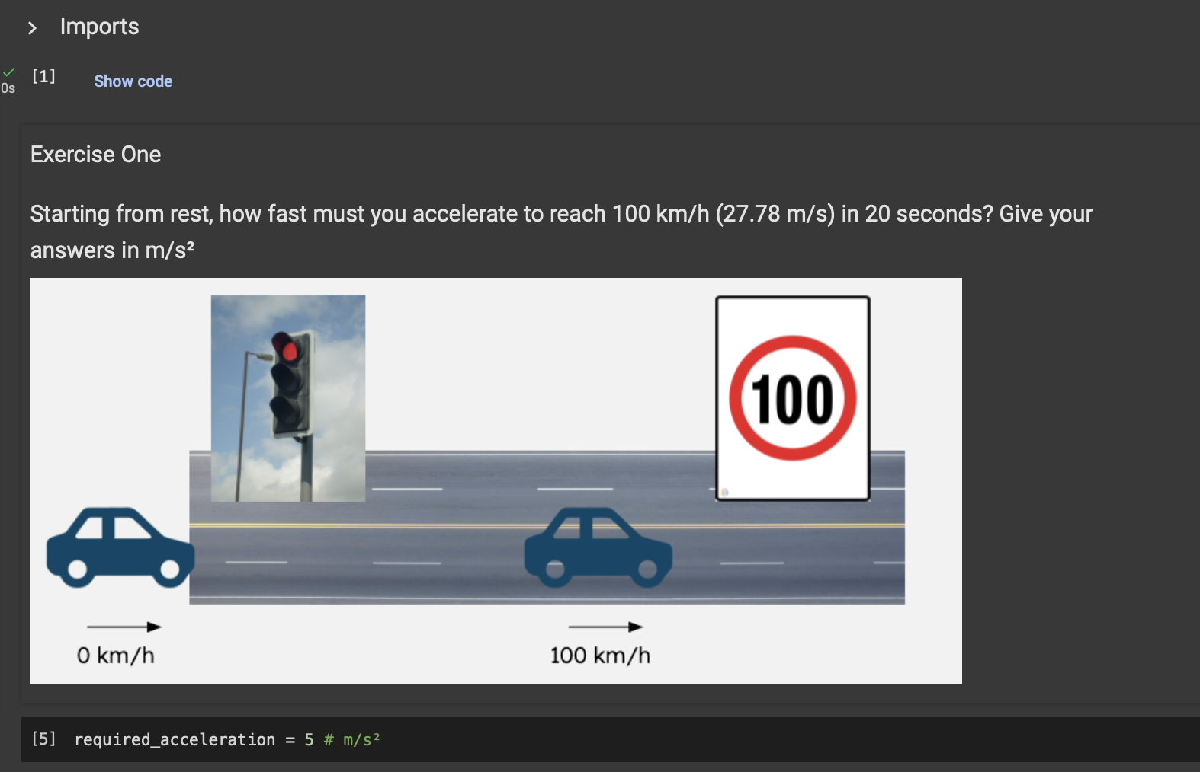
Notes:
A preview of how they should plug in their calculated value in the notebook.

Slide 13

What do you expect the velocity-time graph to look like?

Slide 14
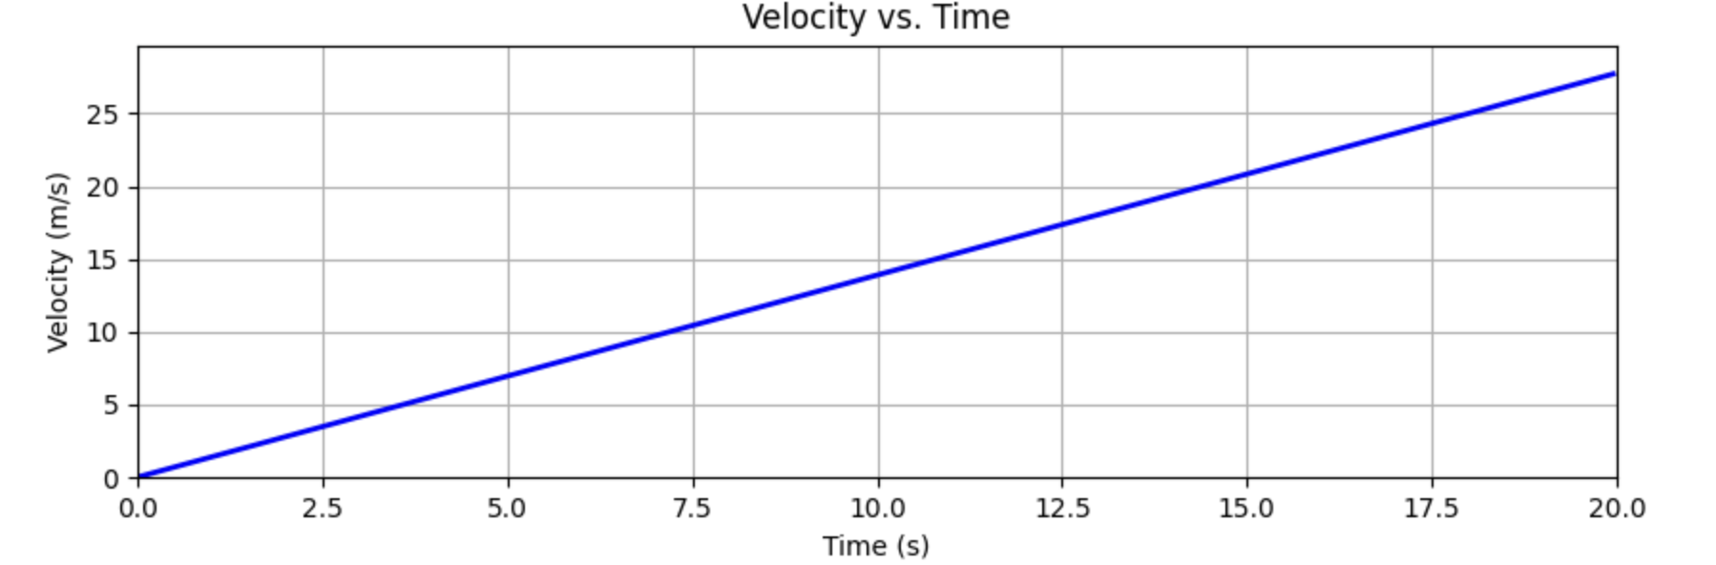
Solution 1
a = 27.78 / 20 = 1.39 m/s²

Slide 15
Exercise 2
How much distance did the car travel?
0 km/h
100 km/h
t = 0 s
t = 20 s
?

Slide 16
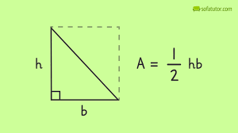
Solution 2
Total Distance = Area under “velocity-time graph”
distance = ½ ⨉ time ⨉ final velocity

Slide 17
Solution 2
Total Distance = 27.78 x 20 / 2 = 277.8 m
distance = ½ ⨉ time ⨉ final velocity

Slide 18
Solution 2
How much distance did the car travel?
0 km/h
100 km/h
t = 0 s
t = 20 s
277.8 m

Slide 19
Exercise 3
The car is still accelerating with constant acceleration.
How much is the acceleration if we know that the travelled distance in 20 seconds is 500 meters?
0 km/h
? km/h
t = 0 s
t = 20 s
500 m

Slide 20
Solution 3
distance = ½ ⨉ time ⨉ final velocity

Slide 21
Solution 3
distance = ½ ⨉ time ⨉ final velocity
final velocity = 2 ⨉ distance / time
Notes:
Add numerical answer

Slide 22
Solution 3
D = 500 m t = 20 sec
V = 2 x 500 / 20 = 50 m/s
a = 50 / 20 = 2.5 m/s

Slide 23
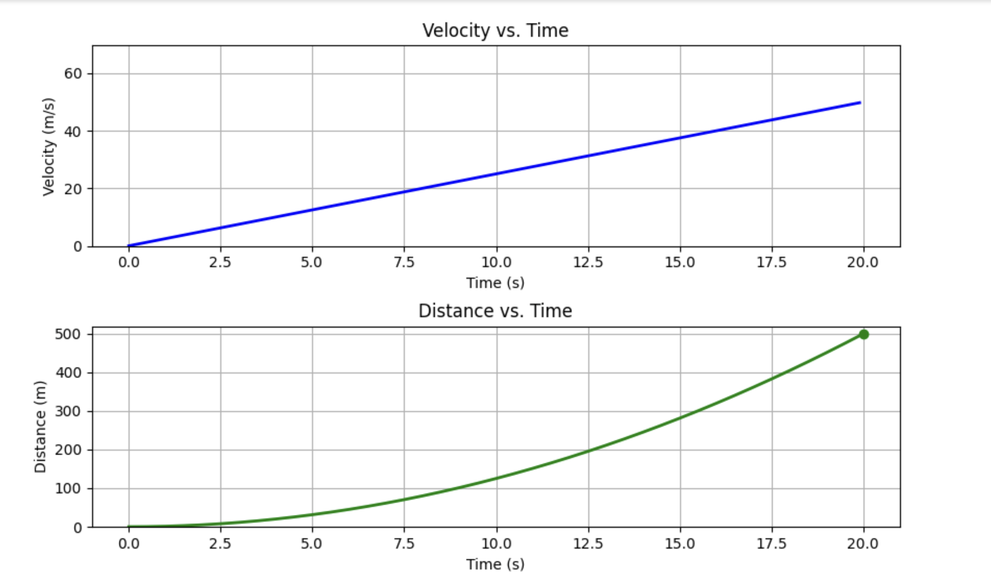
Solution 3
Notes:
If they run the “Check your answer” code for exercise 3, they will obtain both velocity-time and distance-time graphs.

Slide 24
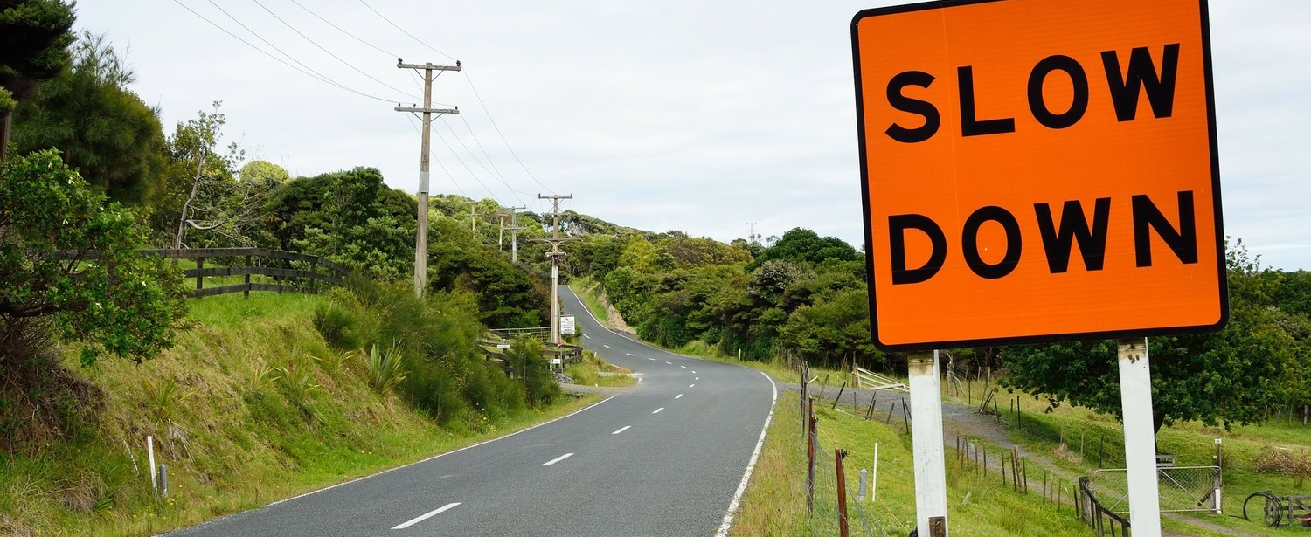
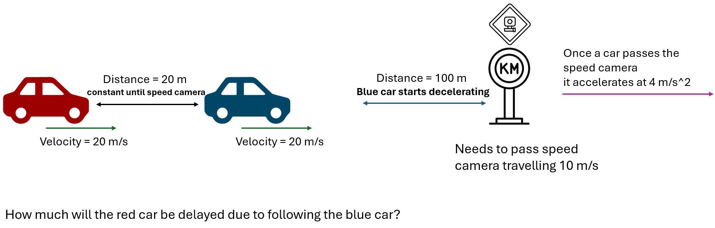
Exercise 4
Notes:
The exercise can be read off the slide. The goal is to find a delay (in seconds) by comparing how quickly the red car would go past the speed camera if it were not following the blue car (but instead alone on the road). The proposed approach to the exercise is to draw a velocity time graph. The final trick in this exercise is to realise that the red car was originally already one second behind the blue car at the beginning.

Slide 25
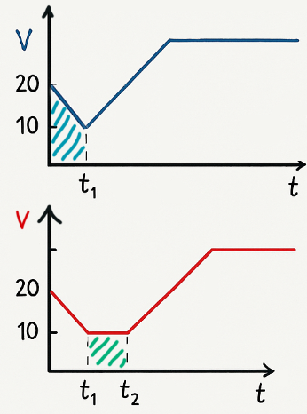
Hint:
Notes:
This hint shows the velocity time graph the students should find

Slide 26
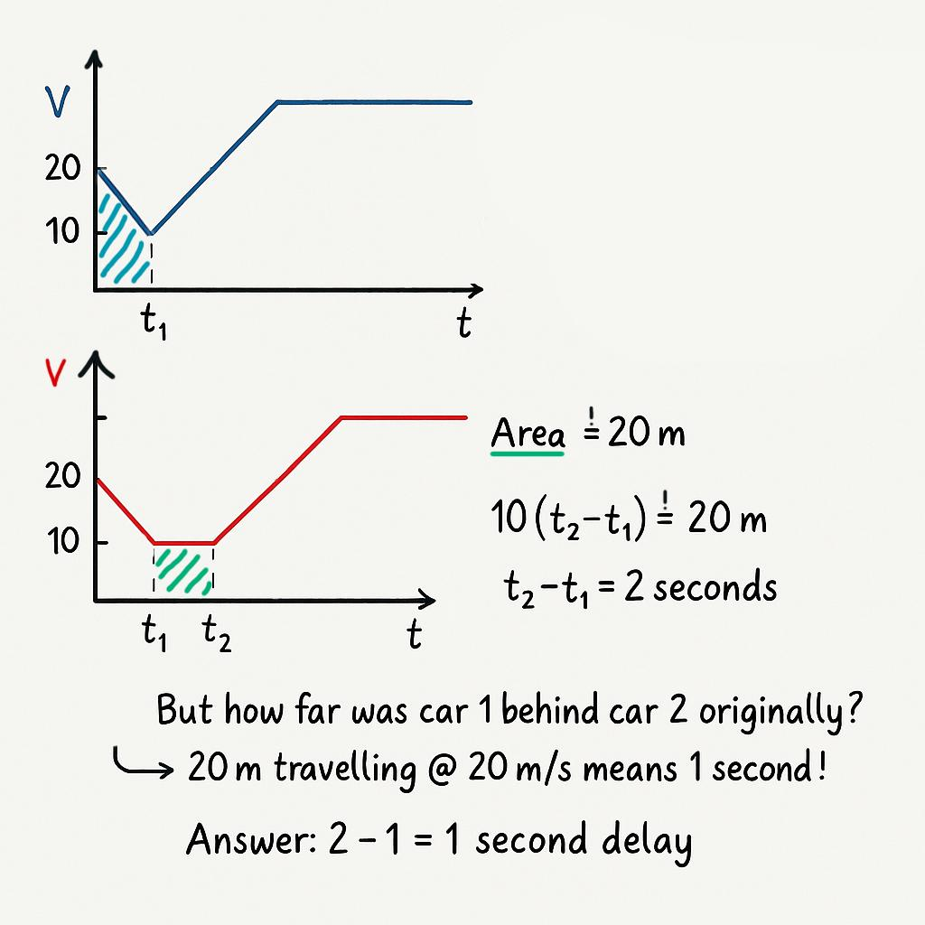
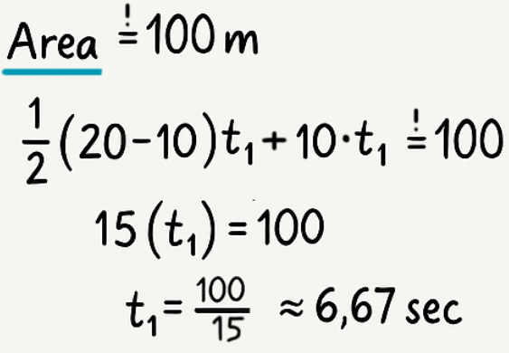
Solution 4
While not strictly necessary to solve this question, some of you might have calculated how long it takes for the blue car to reach the speed camera. This is the correct result if you did so:

Slide 27
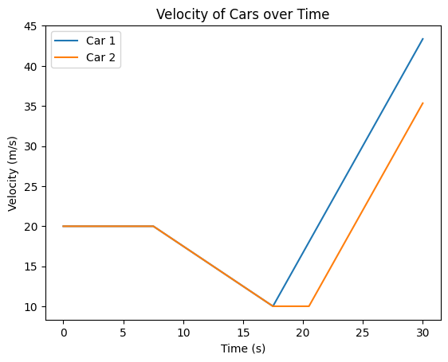
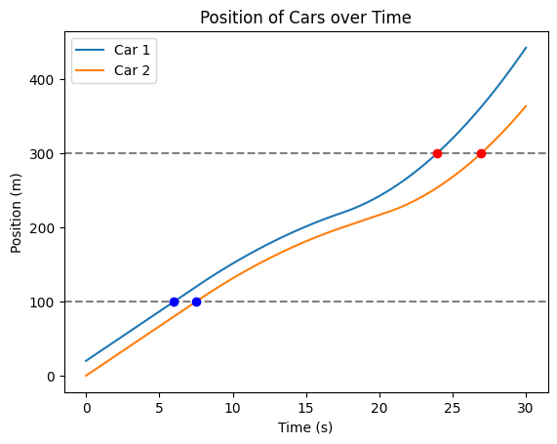
Solution 4
Difference in differences = 1 seconds
Notes:
These are the graphs the students should get once they run the python code associated with the exercise.

Slide 28
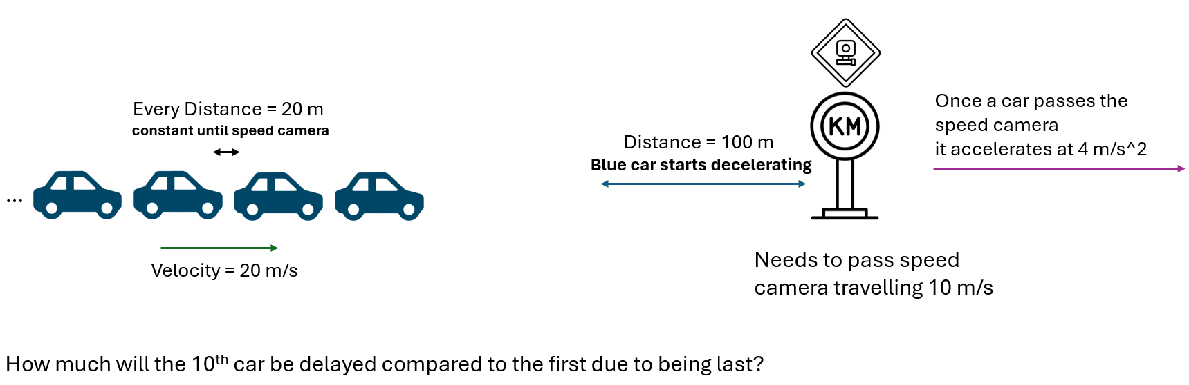
Exercise 5
Notes:
Now the exercise is the same, but there are 10 cars. You can tell the students not to over-think this part. The answer is 9 seconds, it is just multiplying the number of cars which experience delay (9 cars, since the first is not delayed) by the delay per car, which is one second as found previously.

Slide 29
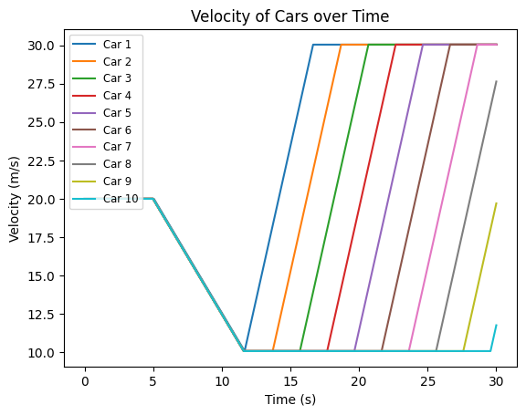
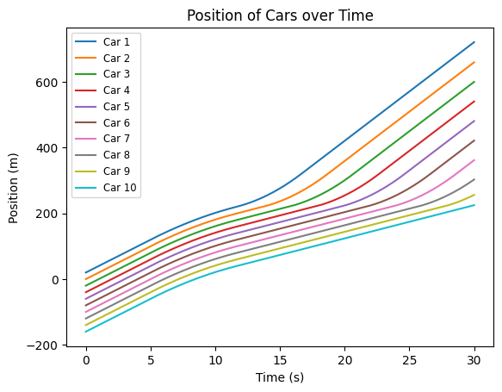
Solution 5
`
Answer = 9 x 1 second = 9 seconds
The trick is to understand that the first car does not have a delay, after that you can just multiply the delay (1 second) by the number of cars
Notes:
Again, the plots the students get from the python script together with the solution

Slide 30
But, this is not very realistic, right?
- Drivers don’t match the speed of the car in front perfectly
- They also don’t keep perfect distances!
How can you calculate how much delayed the 10th car will be if
every driver has a different:
Reaction speed
Acceleration
Comfortable distance of driving behind the previous car
Notes:
Here comes the twist, and this is arguably the most important part of the presentation. Up until now we were building up skills and then doing some problem solving on paper. What this slide should do is get the students to realise that if we step away from these exercise, ideal-world, type of examples and try to tackle a problem in the real world it is not so easy. Something you could do is discuss with the students briefly about why the situation they were solving previously was not realistic. Then together with the class come up with things that should be included in a real simulation (which boils down to drivers being different and not behaving perfectly). Then you can tell the students to solve (on paper) the realistic version of the problem. Of course, that’s not possible for them to do, AND THIS IS WHERE PROGRAMMING COMES IN.

Slide 31
This is something you can solve using programming!
The code has been written for you, and you can use it with making small adjustments.
You can control three parameters for each of the 10 drivers:
Recklessness : more reckless means more acceleration and shorter distance between cars
Choose on a scale 1-10
Driver reaction speed
Choose on a scale of 0.2 seconds-2 seconds
Consider different scenarios, play around with the parameters
Challenge: come up with “realistic” values for reaction speeds. Run some simulations and find out what is the mix of drivers which gives best results in terms of delay
You can make use of the previous code for plotting if you want to!
Notes:
So now the students should use the provided python script to run some simulations which are more realistic. The students should be given time to play around with this code and try out different scenarios.
The actual answer to this question does not matter, the whole idea here is to show students the way someone doing a technical study might approach a problem. Start from a simple calculation on paper and then use tools, such as programming to make it more and more complex. A step which is not done here, but a researcher researching this would do is run thousands of simulations and get some statistics to make predictions about the real world.

Slide 32
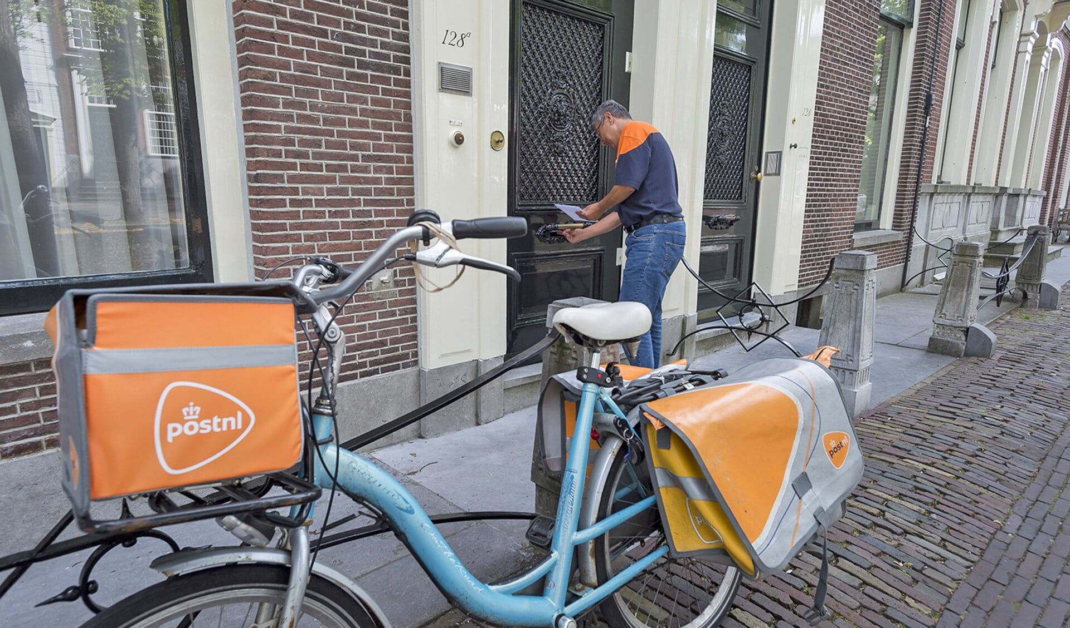
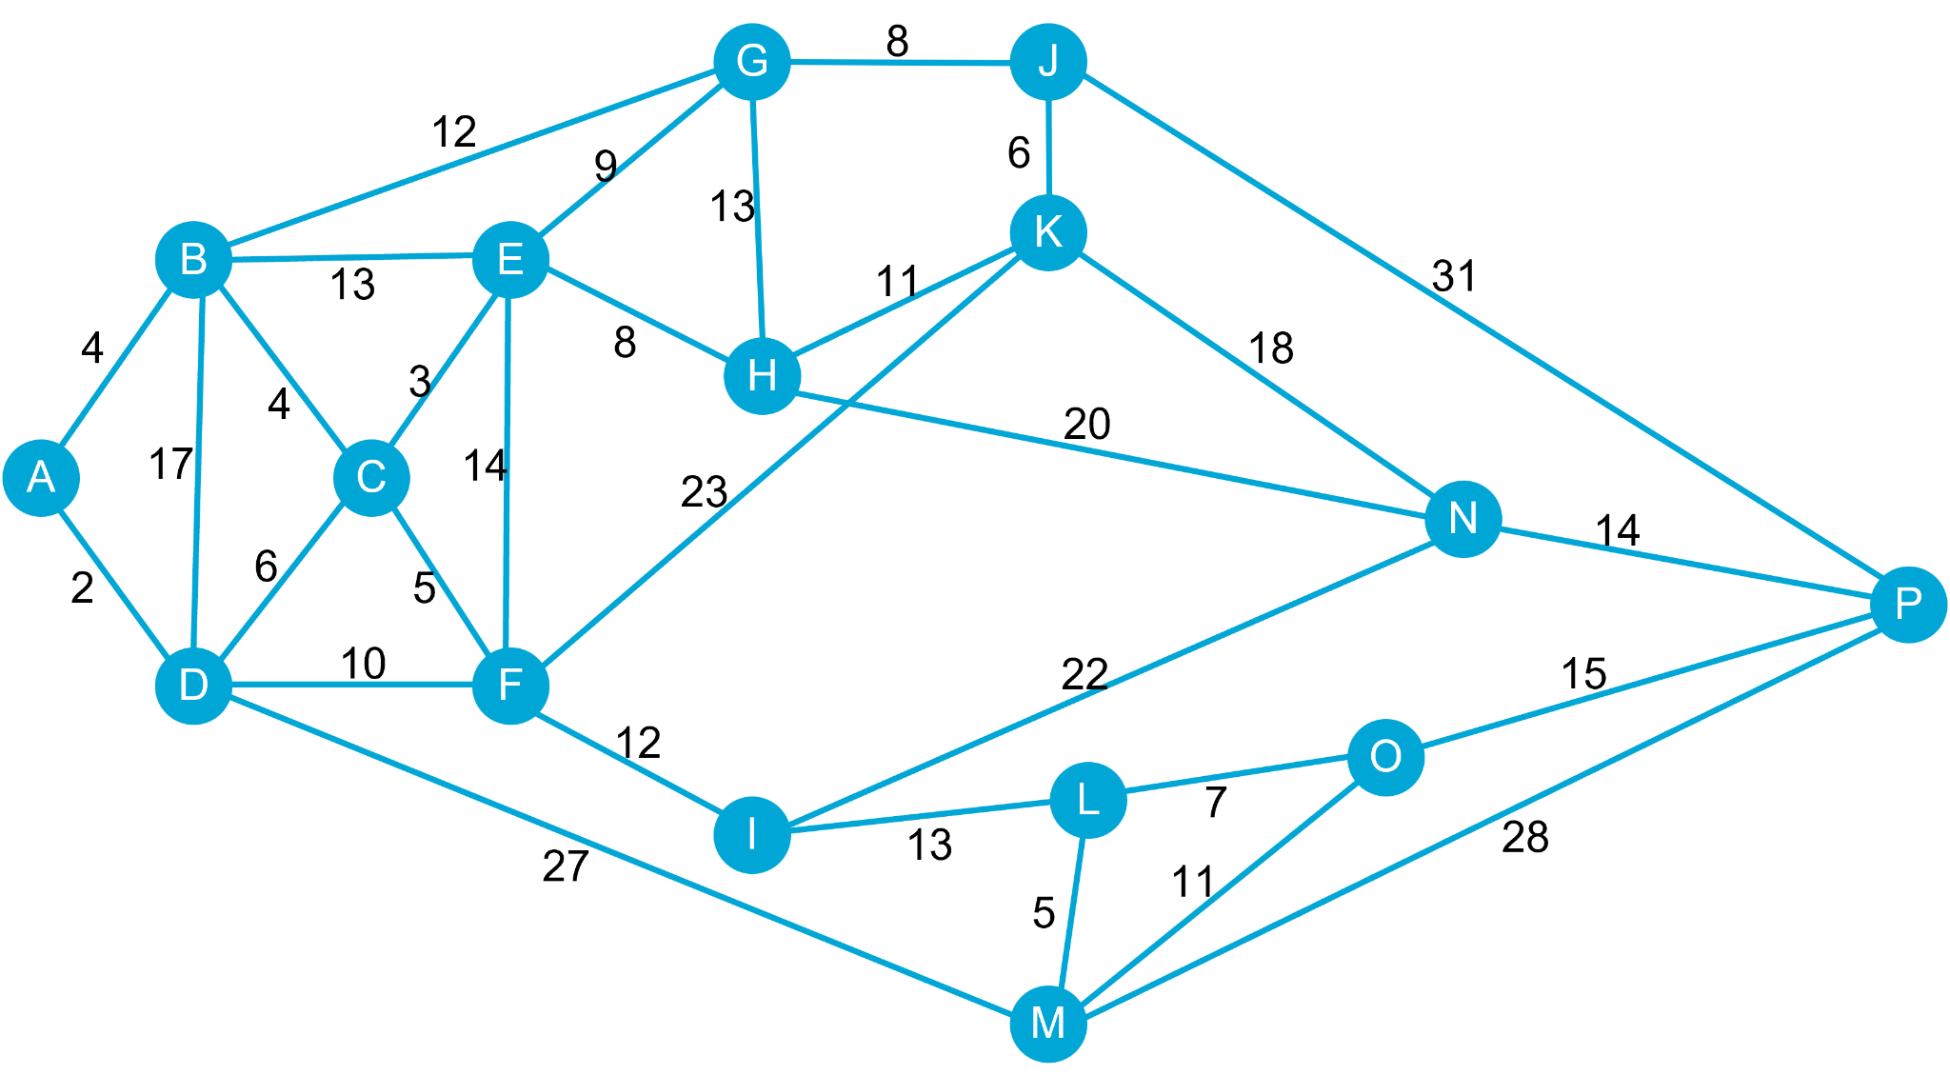
Another challenge: Route Optimization
Why?
Money
Time
Fuel/benzene
People
Climate
Safety
Avoid traffic jams
Energy/effort
….
Notes:
While the previous exercises were mainly focussed no physics/mathematics, we’d like to show the students what other types of problems they could expect.
For example, take PostNL, they provide their drivers with routes past all the locations they have to deliver mail. How do they calculate those routes?
There are so many things to consider!
Would they calculate maybe…
The shortest route? - but what if some of the roads are not suitable for bikers?
The safest route? - for drivers perhaps going by bike?
The quietest route? - what if there are lots of traffic jams in the city?
The cheapest route? - route with perhaps the fewest amount of traffic lights, such that driver is back quickest?
What about a combination of these factors? How would we do that?

Slide 33
Exercise 6
Past all letters
As cheap as possible
You may only pass letter once
Notes:
One way, to solve such a problem, is to add a ‘cost’ to the paths. This cost, can be anything: money, time, fuel, amount of traffic lights, you name it.
And with these costs, you could try to find the ‘cheapest’ route.
You could print the network, and allow students to draw/find the cheapest path. Give them ~approx 5-10 minutes.

Slide 34
Example (not optimal)
Past all letters
As cheap as possible
You may only pass letter once
Total: 185
Notes:
This is an example.
Note that students should find a ‘closed loop’!!
Not pass any letter more than once,
Not pass any path more than once,
Go past all letters
If you’d like to extend this question, you could add, what if the driver could skip just one address (one letter), which one should the driver skip?
The goal is that students realize, that these questions take time, and that, while probably most of them find the answer, it is very hard to know for sure whether it is the cheapest answer, or whether there is another cheaper path.
The answer to the question is: 146, and this is the path: A -> D -> F -> I -> L -> M -> O -> P -> N -> K -> J -> G -> H -> E -> C -> B -> A

Slide 35
Answer
Past all letters
As cheap as possible
You may only pass letter once
Total: 146
Notes:
This is an example.
Note that students should find a ‘closed loop’!!
Not pass any letter more than once,
Not pass any path more than once,
Go past all letters
If you’d like to extend this question, you could add, what if the driver could skip just one address (one letter), which one should the driver skip?
The goal is that students realize, that these questions take time, and that, while probably most of them find the answer, it is very hard to know for sure whether it is the cheapest answer, or whether there is another cheaper path.
To mathematically solve such problems, the traveling salesman algorithm could be used.
The answer to the question is: 146

Slide 36

Question:
What technical studies are there?
Which ones have you heard of?

Slide 37

Flyer
Technical Studies from
TU Eindhoven
TU Delft
Universiteit Twente
Notes:
Next to this lesson, there is a pdf file of a flyer, which contains summaries of all the technical studies from TU Eindhoven, Delft and University of Twente.
Also some additional information, such as advice on how students could find housing or join social activities.

Slide 38
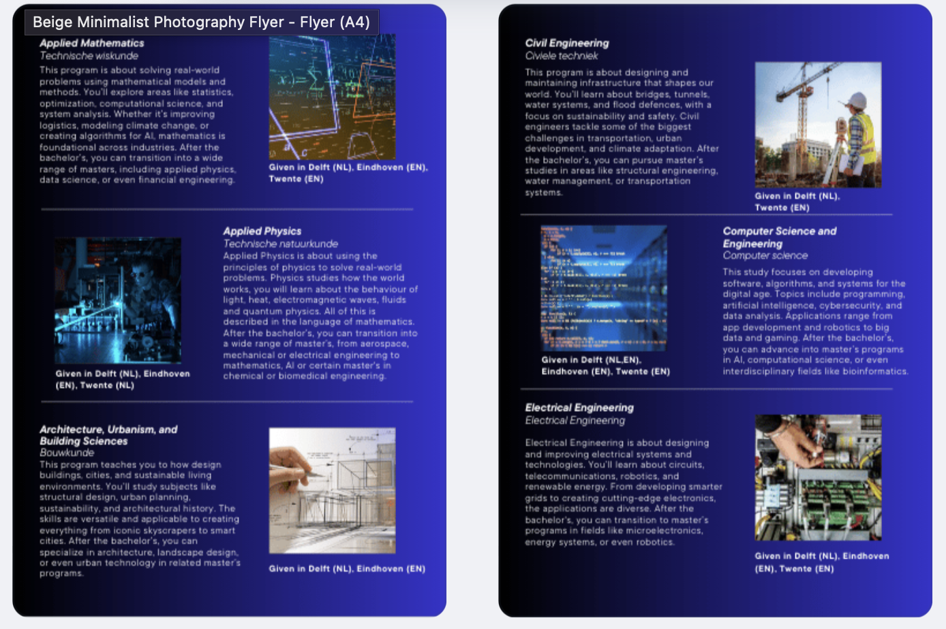
Browse for some background information

